Slide 1
Multilevel Poisson regression using jamovi
Mike Crowson, Ph.D.
March 2020

Slide 2
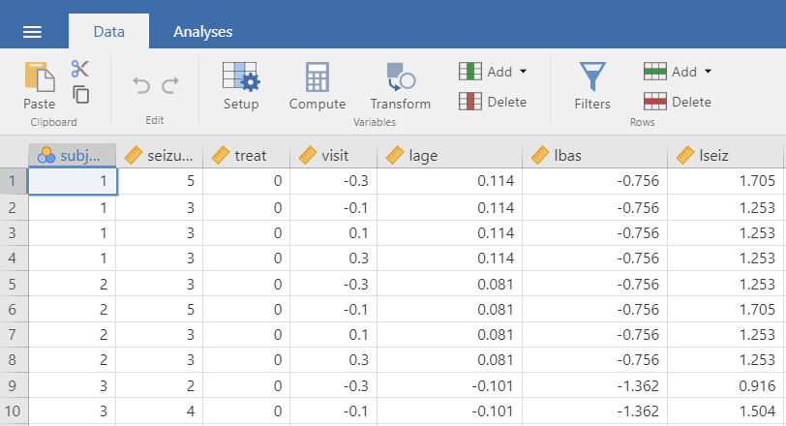
The data and example are based on a presentation in Hox (2010; Chapter 7). Download an SPSS file containing the data at: https://drive.google.com/open?id=1KDRZ2L43dUaqwO7R0a4BumZ38OP_t4dz .
We are predicting the count of epileptic seizures of 59 patients over 4 consecutive visits to a clinic. The Level 1 outcome is ‘seizure’, which is a frequency count of seizures reported at each measurement occasion.
The Level 1 predictor is ‘Visit’, allowing us to model seizure count as a function of time.
The ‘treat’ variable is the Level 2 predictor indicating whether a subject was in a placebo group (coded 0) or a treatment group (coded 1).
A second Level 2 predictor is ‘lbas’ which was the natural log of a baseline count and was centered at its mean.
Hox, J. J. (2010). Multilevel analysis: Techniques and applications (2nd edition). Routledge: New York.

Slide 3
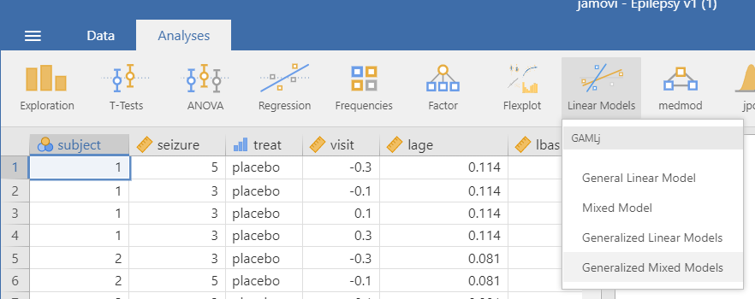

Slide 4
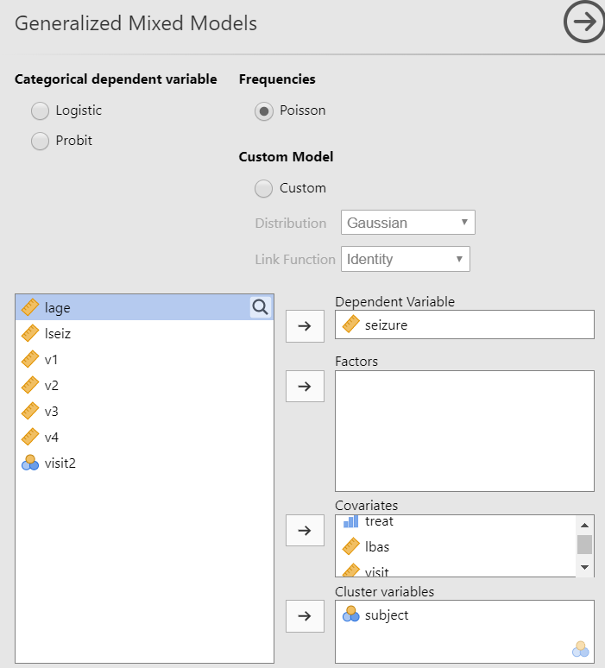
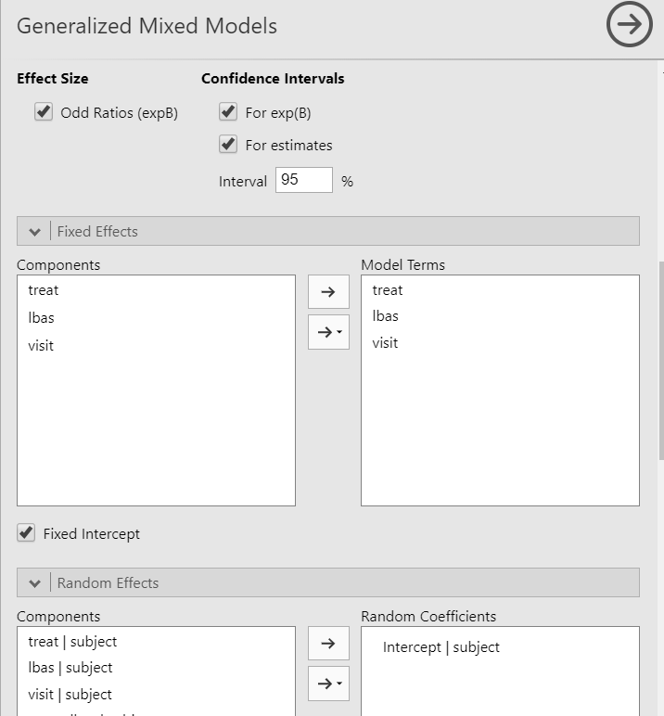

Slide 5
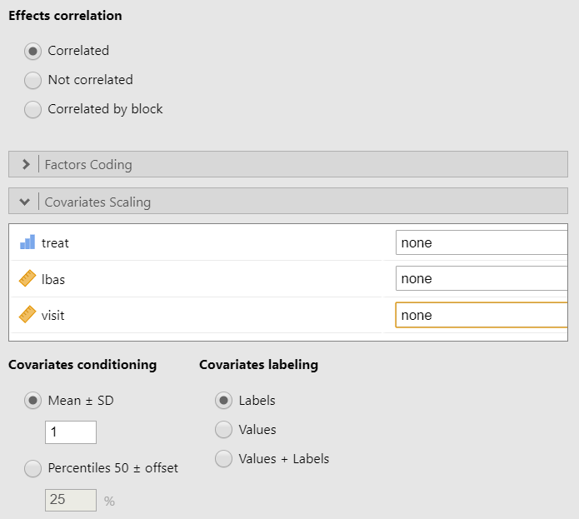

Slide 6
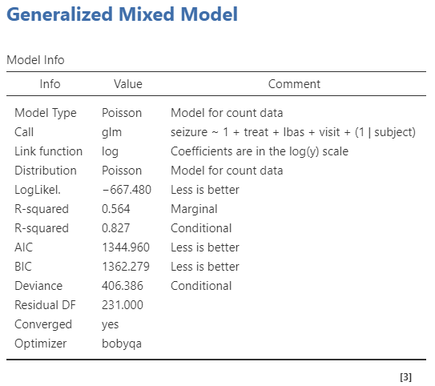
The R-squared indices are interpreted as the proportion of reduction in error as a result of the model’s fixed effects (Marginal R-squared) or the model’s fixed + random effects (Conditional R-squared).
For more details on these indices and others in this table, see https://gamlj.github.io/gzlm_specs.html
The Marginal R-squared can be interpreted the following way: Our ability to predict the count outcome is increased by 56% with the addition of the fixed predictors (see similar presentation here in the context of multilevel logistic regression: https://gamlj.github.io/gzlm_example2.html).

Slide 7
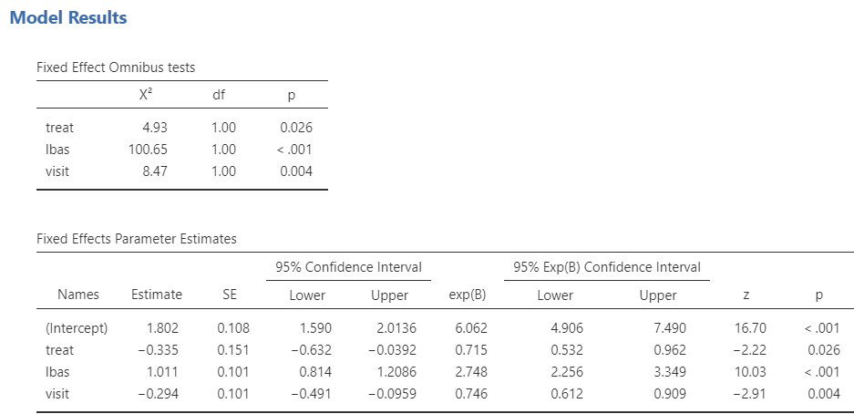
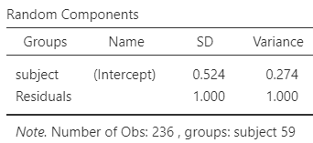
The ‘Estimate’ column contains regression coefficients and represents the predicted change in log counts per unit increase on a predictor, controlling for the remaining predictors. The exp(B) column refers to the incidence rate ratio (IRR) for the predictors. The IRR associated with a predictor indicates the multiplicative change in the incidence rate per unit increase on that predictor. For more helpful details on interpreting IRR, see https://stats.idre.ucla.edu/stata/output/poisson-regression/

Slide 8
The intercept in this model is the expected log count of individuals in the placebo group (treat coded 0) for participants with an average (log) baseline seizure count around the midpoint of the 4-week study period (there is no ‘0’ value on the time/visit variable; but 0 falls equidistant from the first visit coded -.3 and the last coded .3). The Level 2 treat variable was a negative and significant predictor (b=-.335, p=.026) of the expected log count. Given the coding of this variable (0=placebo, 1=treatment), the negative coefficient indicates that the expected (log) count for epileptic seizures is lower in the treatment group relative to the placebo group. The exp(B) value associated with the treatment predictor indicates that the incidence rate for the treatment group is .715 times that of the placebo group.

Slide 9
The Level 2 predictor ‘lbas’ was positively and significantly predictive of the expected log count (b=1.011, p<.001). This indicates that individuals whose baseline log seizure count was associated with a higher (log) seizure count at each visit. The value in the exp(B) column for ‘lbas’ can be interpreted as the multiplicative change in log count per unit increase on the predictor, with the incidence rate changing by a factor of 2.748 per unit increase on the predictor.
The Level 1 predictor ‘visit’ was a negative and significant predictor of expected log count (b=-.294, p=.004), indicating that over the study period the expected log (seizure) count decreased over time/visits.

Slide 10
There is no Level 1 variance estimate. The only variance estimate in this model is at Level 2 (which is for the intercept: variance=.274).

